Slide 1
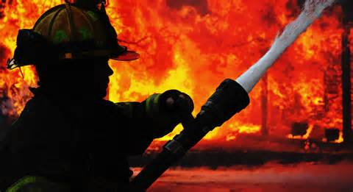
Southern Maryland Brew & BBQ Festival
1st Annual Firefighter Skills
Challenge
Dates: August 2, 2014
Location: St. Mary’s County Fairgrounds 42455 Fairgrounds Road, Leonardtown MD 20650
Event Hours: 5pm-8pm
Contact Information: Tommy Mattingly
tjrmattingly@lvfd1.org
Event Information: $1500 Competition Purse
1st Place - $750
2nd Place - $500
3rd Place - $250
Prizes donated to Fire Department of winning teams
Trophies for the top 3 teams for individuals to take home
CAN YOU TAKE THE HEAT!

